Slide 1
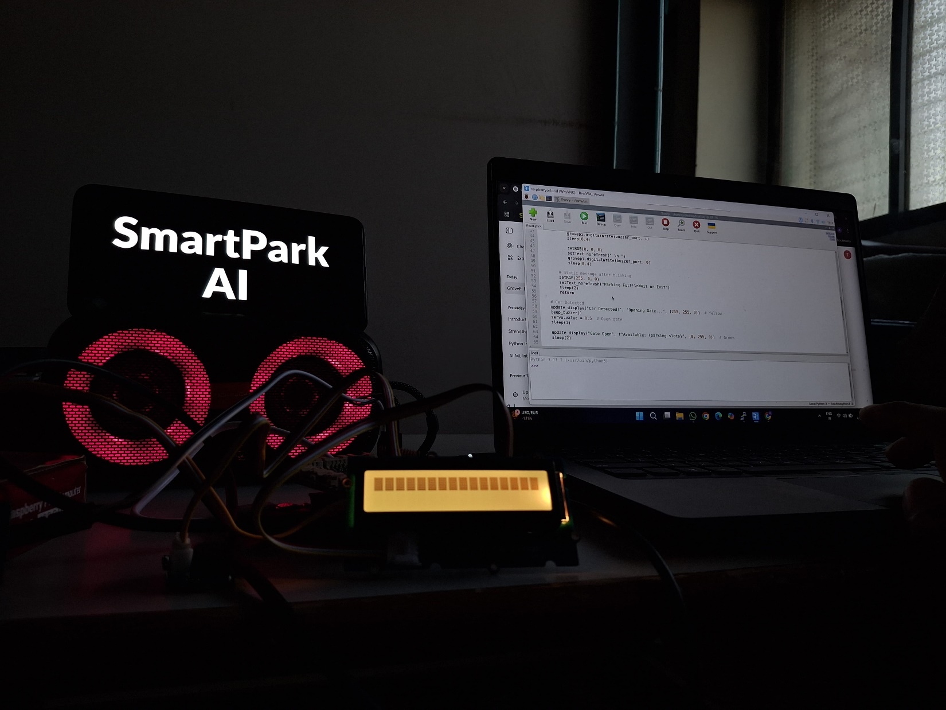


Presenting by:
        Tirth Babariya
        Jay Sudani
        Tushar Laskhari
        Meet Chovatiya

Slide 2

Project Objectives
Problem Statement
Project Overview – Introduction
End Users
Wow Factor in Project
General System Overview
Modelling
Conclusion
Future Perspective

Slide 3
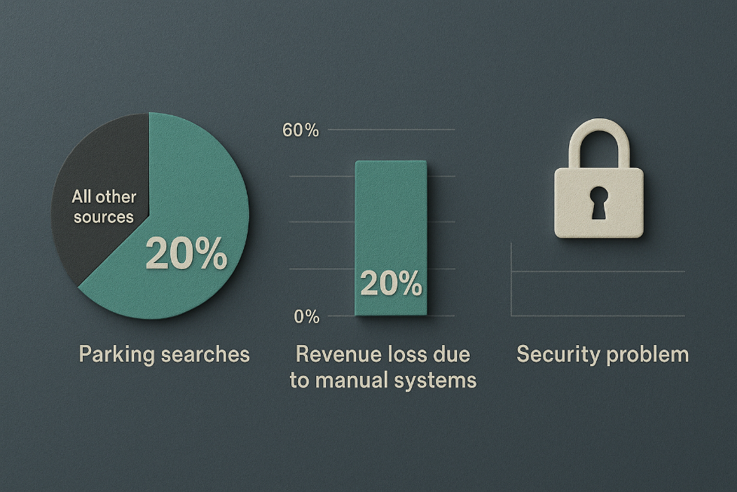
Problem Statement
Key Issues:
  30% of urban traffic caused by parking searches (cite IBM).
  15% revenue leakage in manual systems.
  No real-time slot visibility → driver frustration.

Slide 4
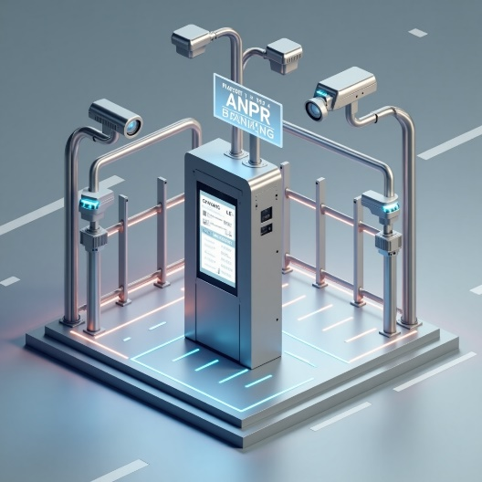
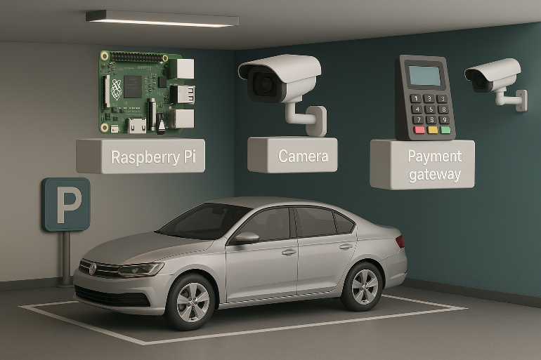
Project overview - Introduction
Solution Architecture:
ANPR using YOLOv10 + PaddleOCR
→High-accuracy license plate detection and recognition.
IoT Ultrasonic Sensors
→ Real-time detection of available parking slots.
Hybrid Payment System
→ Supports both QR payments and cash transactions.

Slide 5
End User
Who Benefits from SmartPark AI?
Drivers:
Benefit: Faster parking, real-time updates via app.
Persona:
Rahul, Delivery Driver
“I need a quick place to park, especially in crowded areas!”
Operators:
Benefit: Fraud-proof payments, powerful analytics dashboard.
Persona:
Priya, Mall Manager
“I want clear revenue reports and reduced complaints.”
City Planners:
Benefit: Access to real-time data for smart city integration.
Use case: zoning decisions, traffic flow analysis, sustainability impact.

Slide 6
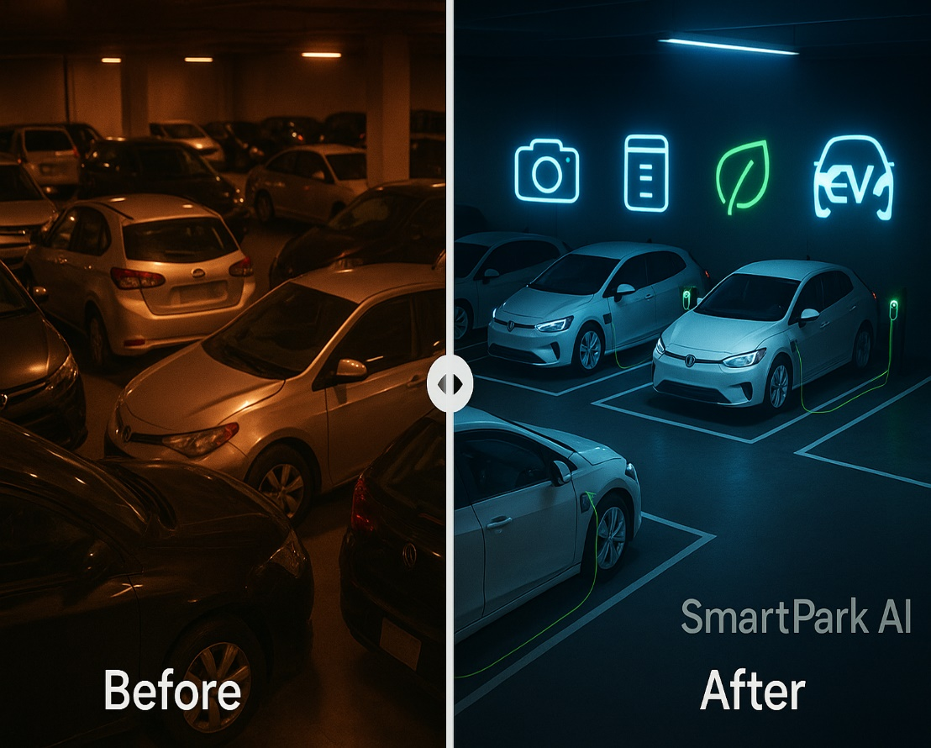
Wow Factor in Solution
Why SmartPark AI Stands Out ?
95% ANPR Accuracy:
  Works even in low light
  Recognizes angled plates
Dual Use Cases:
  Paid Parking – Malls & commercial zones
  Free Access – Offices with RFID-tagged staff
  Sustainability Impact:
  Reduces idle search time
  40% CO₂ reduction in trial zones

Slide 7
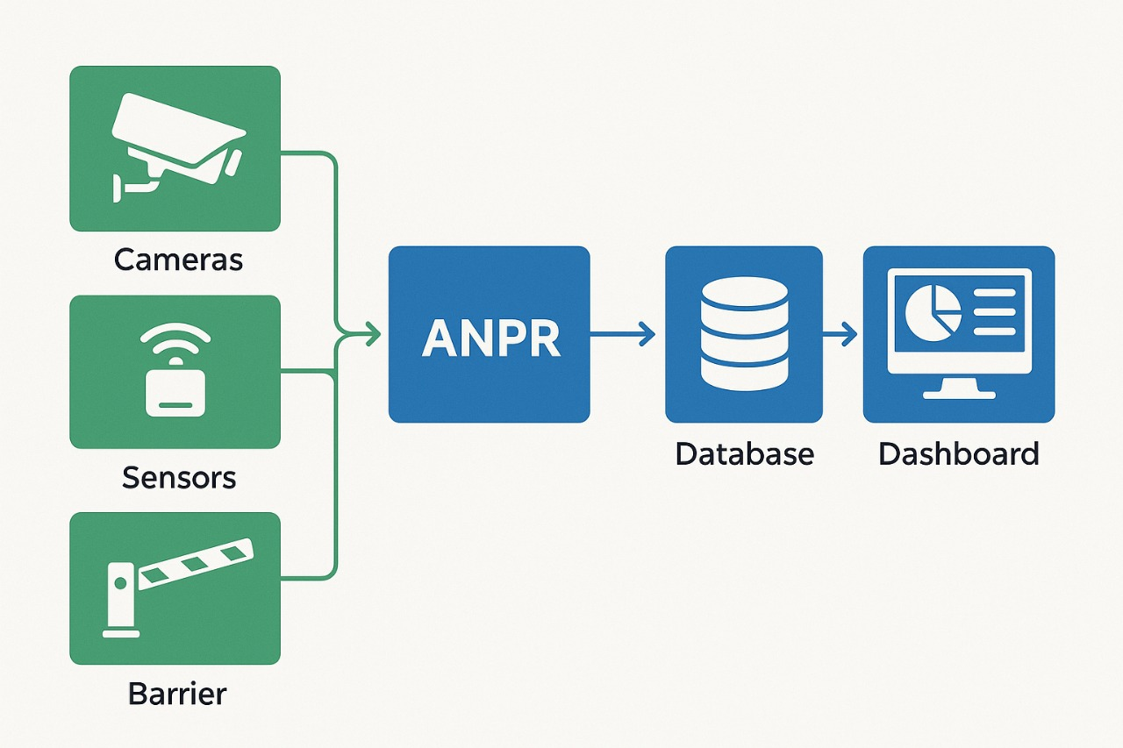
General System Overview
Key Components:
Entry Gate:
  ANPR camera scans license plates.
  Automated barrier control for access.
Sensors:
  Ultrasonic for detecting slot occupancy.
  RFID tags for employee/staff entry.
Dashboard:
  Real-time display of available slots.
  Transaction records and payment logs.
  Heatmaps of usage and peak hours.

Slide 8
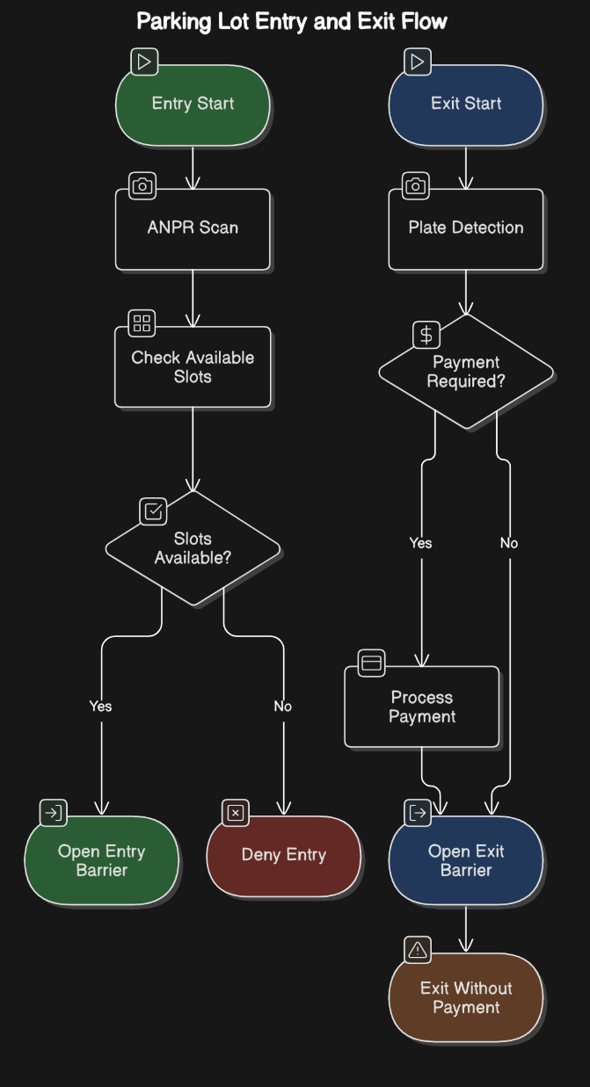
Modelling
Entry Flow:
ANPR Camera Scan – Vehicle license plate is detected.
Slot Availability Check – Backend system verifies free slots.
Barrier Opens Automatically – Entry is seamless and touch-free.
Exit Flow:
Exit Plate Recognition – Confirms same vehicle.
Instant Payment Triggered – Based on duration.
Barrier Opens – Exit logged with timestamp.

Slide 9
Conclusion
Impact:
Reduced Urban Traffic: Fewer cars circling for parking.
Smart City Ready: Easily scalable with city infrastructure.
Energy Efficient: Supports EVs and solar-powered solutions.
Call to Action:
Let’s Partner Up!
Launch pilot programs with local malls, hospitals, and tech parks.
Validate real-world benefits of SmartPark AI.
Shape the future of intelligent urban mobility—together.

Slide 10
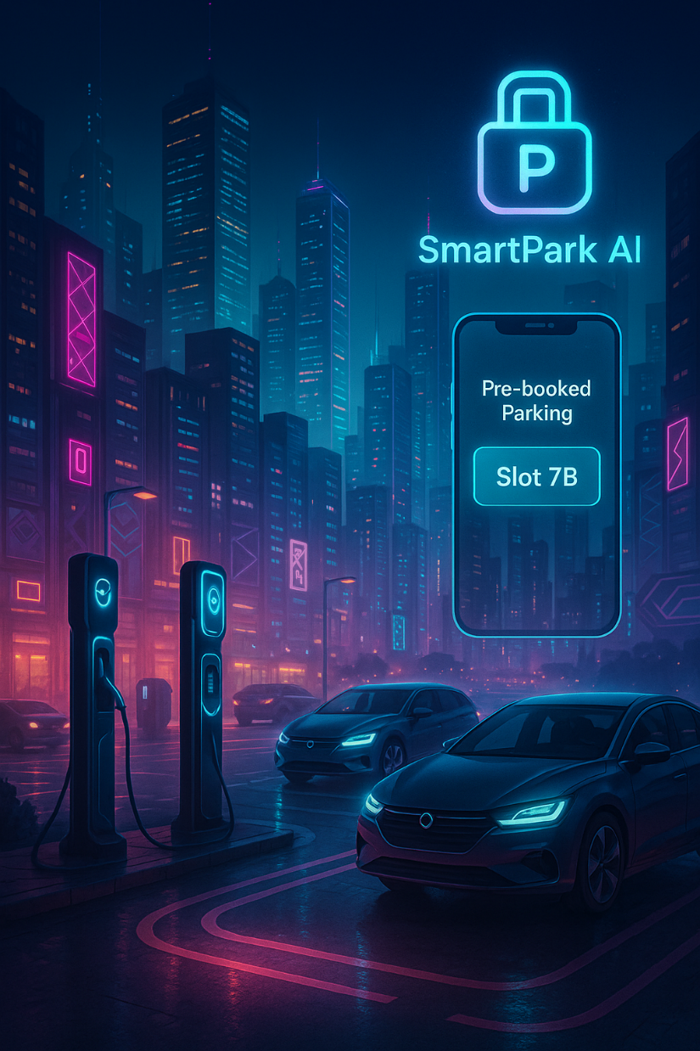
Future Perspective:
Content Blocks:
Mobile App:
Pre-book parking slots from anywhere.
Dynamic pricing based on demand & time.
EV Charging:
Priority parking for EVs.
Solar-powered, sustainable stations.
AI Expansion:
Predictive analytics for demand trends.
City-wide parking optimization.

Slide 11
Thank you...!

